Slide 1
TASK-3
CALCULATOR & TEXT EDITOR
FRONT-END DESIGN

Slide 2
LMS USER NAME | NAME | BATCH
2129a41127 | Balaji.s | A41
2129a41128 | Chandru.G | A41
2129a41129 | Devanathan.R | a41
2129a41130 | Dharani.S | a41

Slide 3
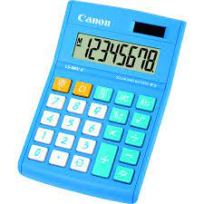
CALCULATOR
A calculator is a machine which allows people to do math operation more easily for eg,most calculator will add,subtract ,multiply and divide
Calculator basis calcultors are great for solving simple equivalent with one or two variables but scientific calculators allow you to input a problem that has an order of operation

Slide 4

text editor
A text editor is a tool that allows a user to create and revise documents in acomputer.though this task can be carried out in other modes the word text editor commonly refers to that does this interactively

Slide 5
Step wise description
Create the structure with html
Style with css
Review
Develop
Test
Launch

Slide 6
summary
Front-end development is the process of building components that interacts with users.
Front-end develops websites and applications using web techonologies like html,css,javascript,and dom .

Slide 7
setup project for calculator project
setup basic structure of text editorproject
create a main component with outer structure ofcalculator
check list
create main component with all feature buttons
create button components with on click handler
create a json object to store data for text editor
create evaluate expression function to evalute value
push both code to github

Slide 8
insert your github link here

Slide 9
THANKS!

